Slide 1
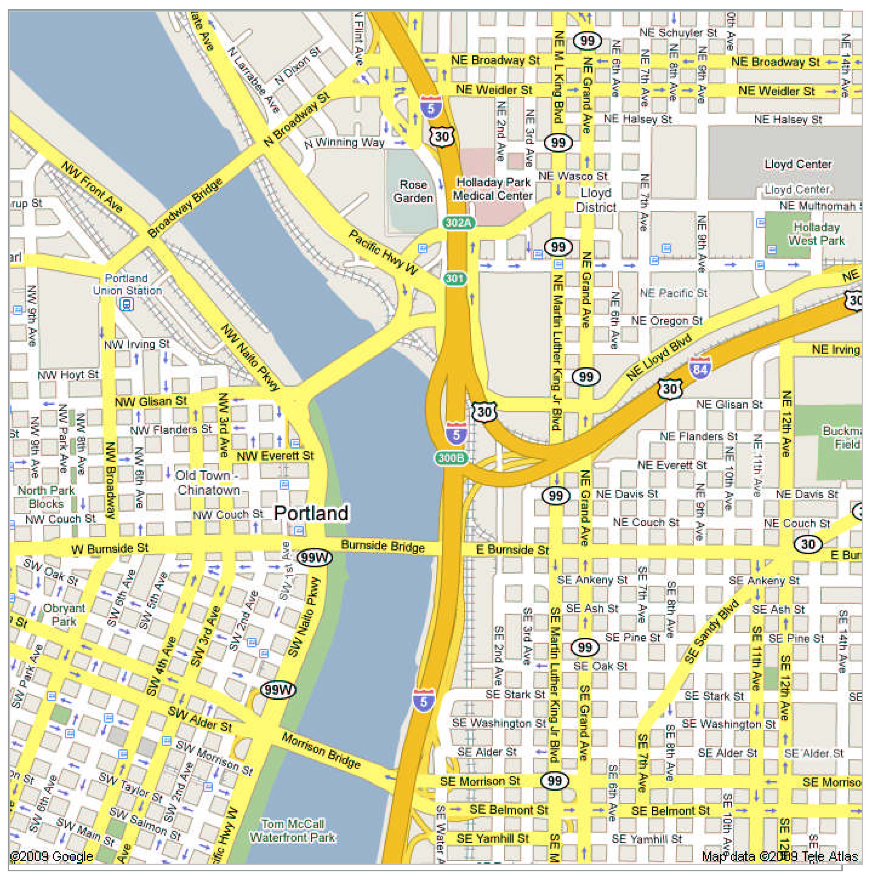


Geo-Seek.
By: Bryan Bradley, Jonathan Green, Alexa LaMontagne, Andy Santiago

Slide 2

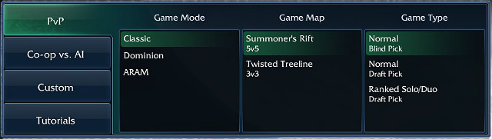
Project Overview
Geo-locational game of hide and seek
Multiple Game Modes
Hide and Seek
Sardine (Possibly)
Assassins (Possibly)
Invite friends to a game session!

Slide 3


Geo-Seek Users
You!!!
And your friends!!!
Host a game with invites.
Join a friend's game.
Available on Android

Slide 4
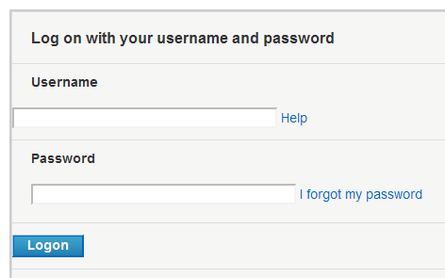

Functional Requirements
Login with user name and password
Invite Geo-Seek friends to a game session.
MapsView (Google Maps)
Limited number of refreshes
A timed game session.
GPS tracking of Seeker's current location
and Hiders' approximate locations.

Slide 5


Database Entities
User
GameSession
Hider
Seeker
Location
Device
Possible Hider
Location
Seeker
Actual Hider
Location

